Slide 1
Analyzing the Relationship Between Conflict and Water Scarcity
Team 2
Team Members
Chris Kellam
Matthew Smith
Jason Britton
Molly Fox

Slide 2
Water Scarcity and Global Conflict Analysis
Explore the complex relationship between armed conflict and water scarcity by leveraging geospatial and environmental data to assess how water scarcity influences the occurrence and intensity of conflicts.
Hypothesis: Water is one of the most critical resources on the planet for human survival. When the demand for critical resources, such as water, exceeds the supply the number of conflicts increases.

Slide 3
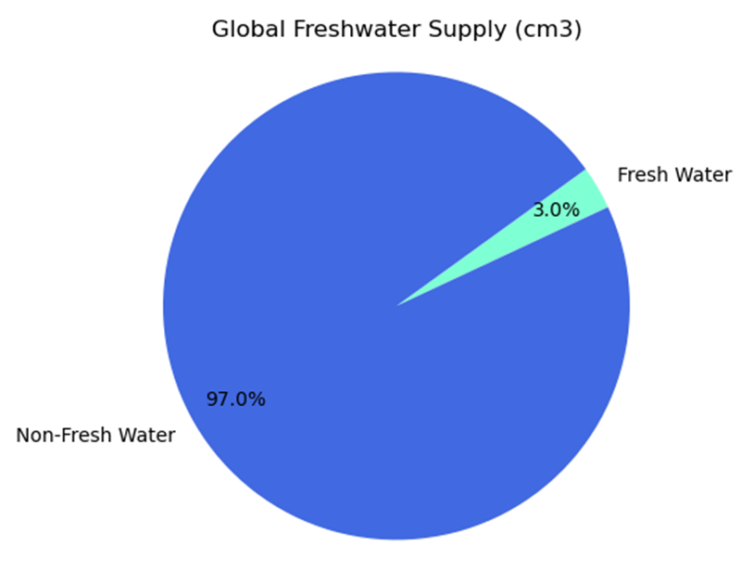
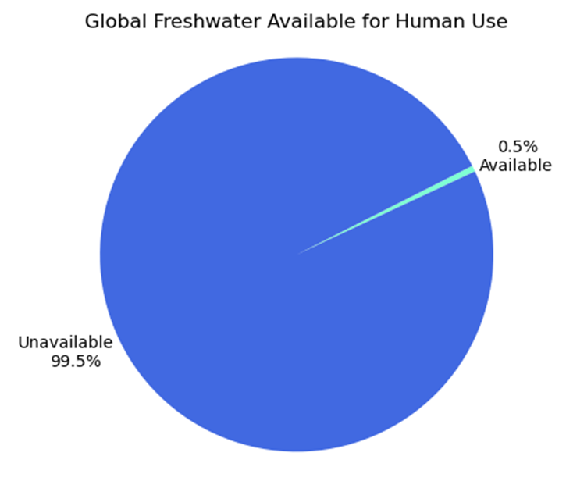
Why explore Water?
Water is critical to human survival.
Only 3% of the world's water is freshwater, and only 0.5% is available for human use.
Water is inherently scarce, which could increase conflict.

Slide 4
Project Summary
Task 1: Data Collection
Task 2: Data Cleanup
Task 3: Data Integration
Task 4: Analysis
Task 5: Visualization
Topics
Does water scarcity correlate with frequency and intensity of armed conflicts?
What are the geographical patterns of conflict relative to water scarcity?
Can changes in water availability predict increases in conflict events?
Are certain types of conflicts more likely to occur in water-scarce regions?
Are there other factors that affect the frequency of armed conflicts in water scarce areas?
Sociopolitical
Geographical

Slide 5
Task 1: Data Collection
Bureau of Reclamation: Global Water
Food and Agriculture Organization (FAO): Water Stress
University of Alabama: Militarized Events
Correlates of War (COW): Countries
GitHub: Regions & Sub-Regions
World Bank Group: Political Stability, Precipitation, Freshwater
International Monetary Fund: Surface Temperature

Slide 6
Task 2: Data Cleanup
Militarized Events Data provided data for eventnum as a sequential battle in a greater war or conflict represented by micnum. We
We compared the datasets and selected a date range where data was well represented: 1980 - 2014
We kept nulls in/out because?

Slide 7
Task 3: Data Integration
We individually integrated cleaned up csv files within our topic areas. This allowed us to select which datasets applied to our specific topic areas for analysis.

Slide 8
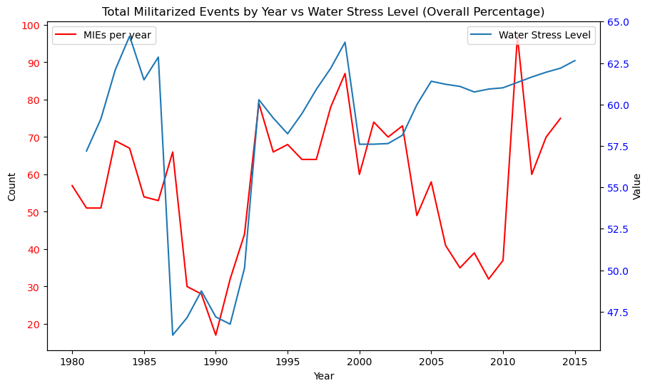
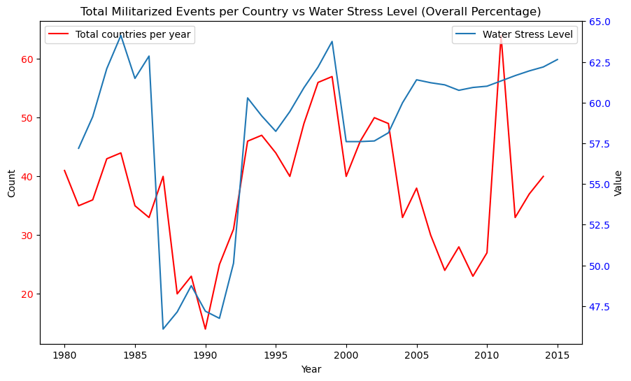
How does water scarcity correlate with the frequency and intensity of armed conflicts?

Slide 9
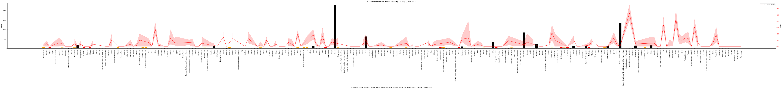
What are the geographical patterns of conflict relative to water scarcity?

Slide 10
Can changes in water availability predict increases in conflict events?

Slide 11
Are certain types of conflicts more likely to occur in water-scarce regions?

Slide 12
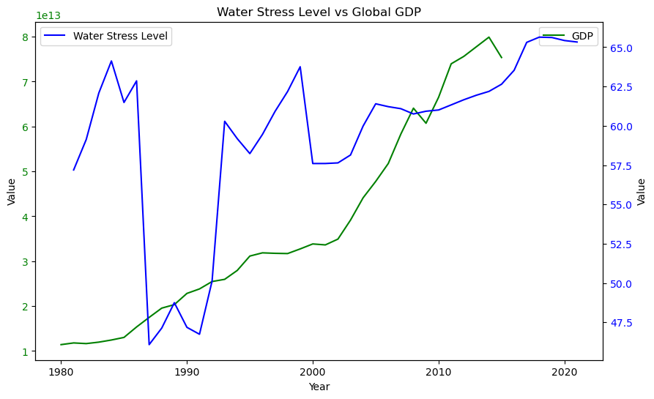
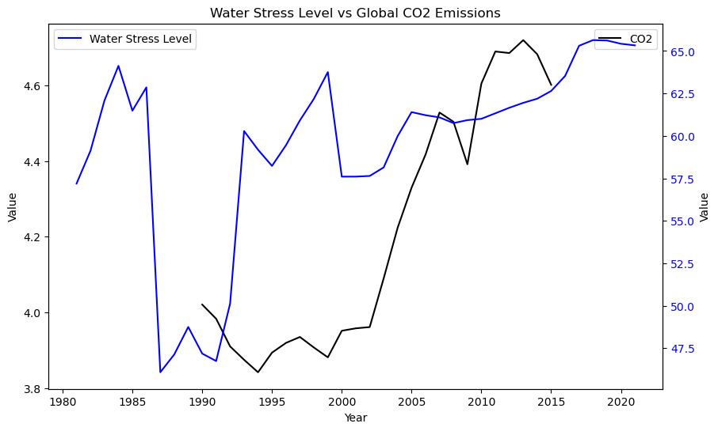
Are there other factors that affect the frequency of armed conflicts in water scarce areas?

Slide 13
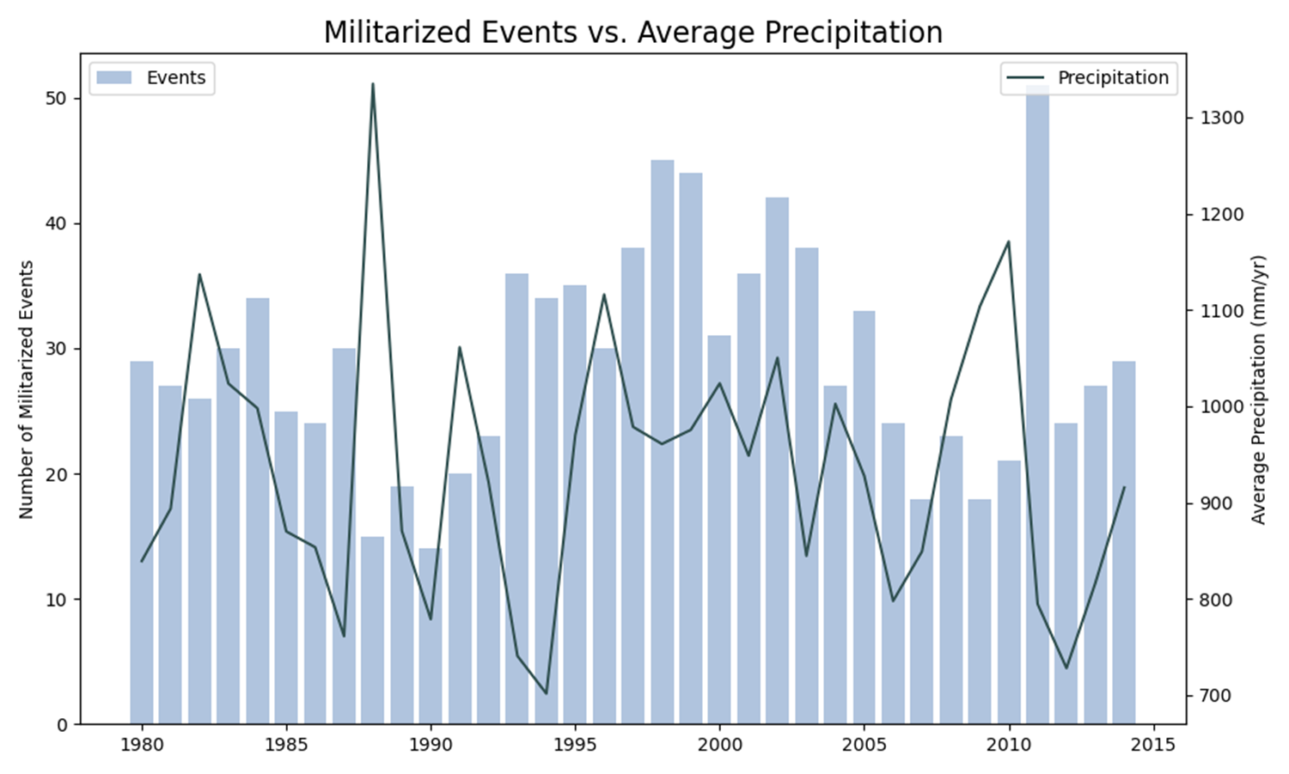
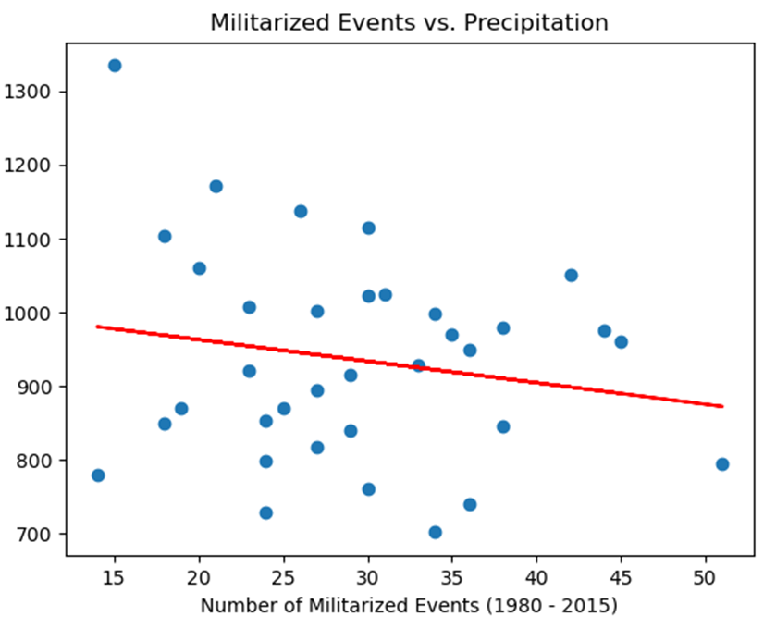
Topic 4: Average Precipitation Analysis
Conflicts and precipitation over time appear to be slightly correlated.
The calculated r-value is 0.03, indicating almost no correlation.

Slide 14
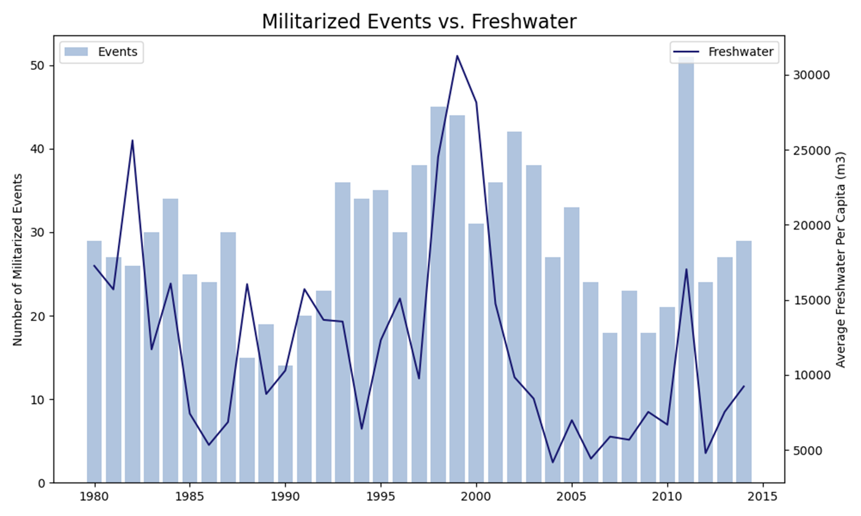
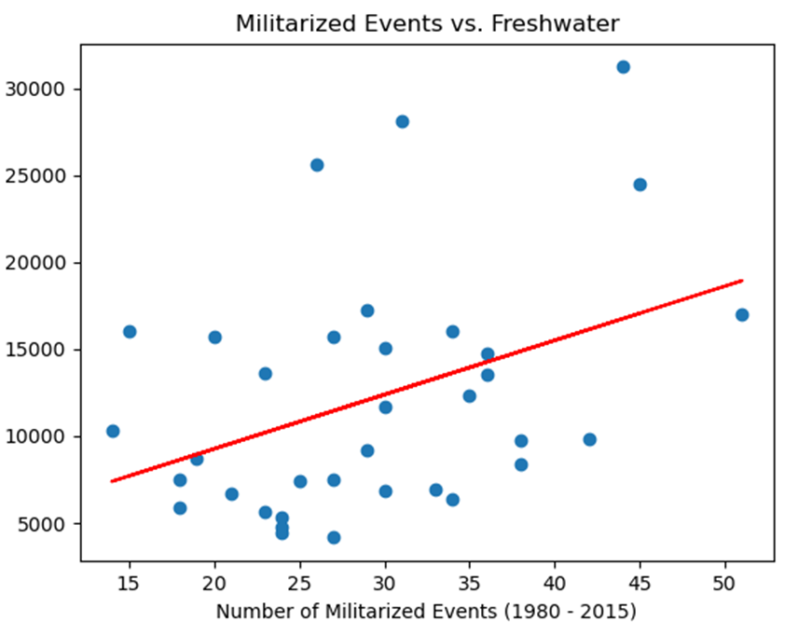
Topic 4: Average Freshwater Analysis
Conflicts and Freshwater over time appear to be slightly correlated.
The calculated r-value is 0.16, indicating a very weak positive correlation.

Slide 15
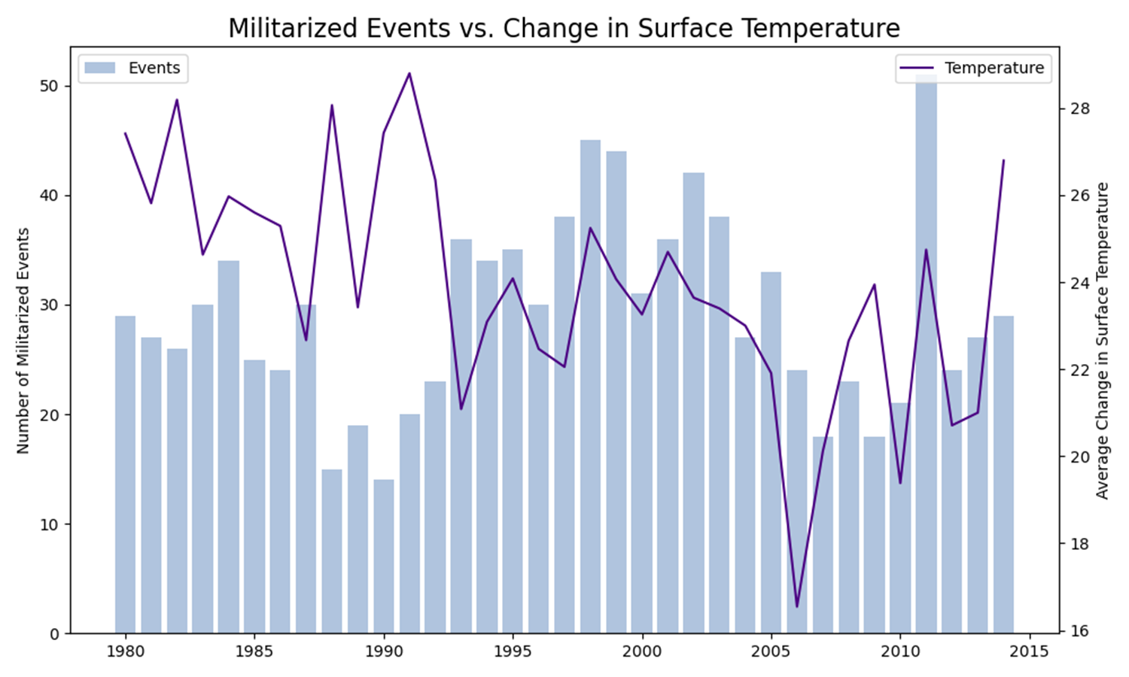
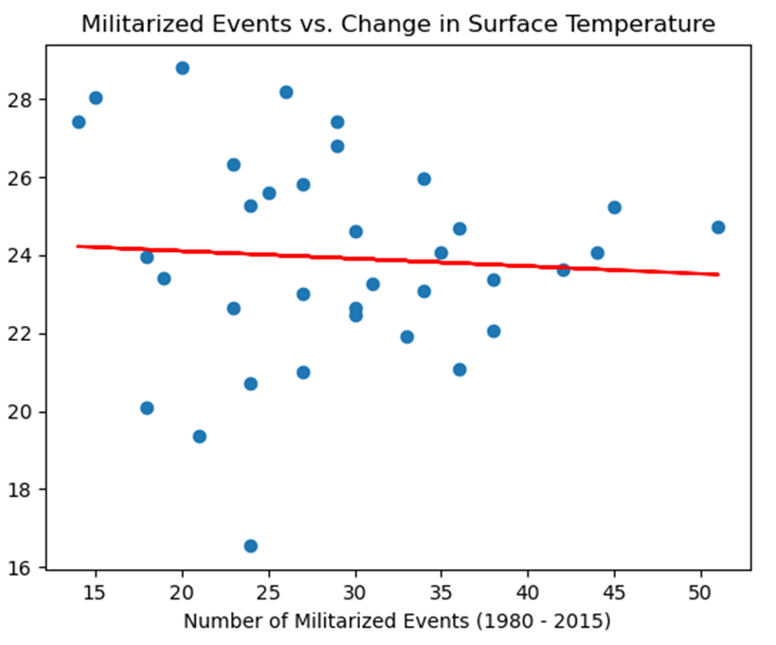
Topic 4: Average Surface Temperature Analysis
Conflicts and surface temperature over time appear to be slightly correlated.
The calculated r-value is 0.04, indicating almost no correlation.

Slide 16
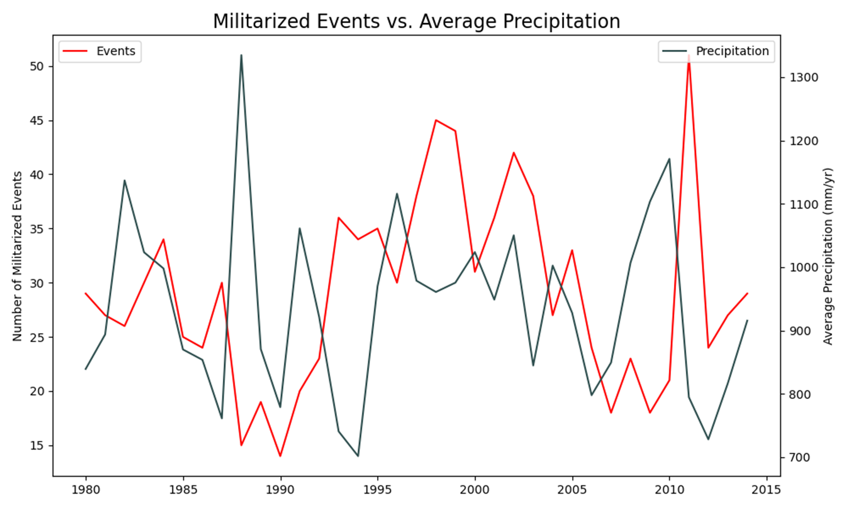
Topic 4: Average Precipitation Analysis
Conflicts and precipitation over time appear to be slightly correlated.
The calculated r-value is 0.03, indicating almost no correlation.

Slide 17
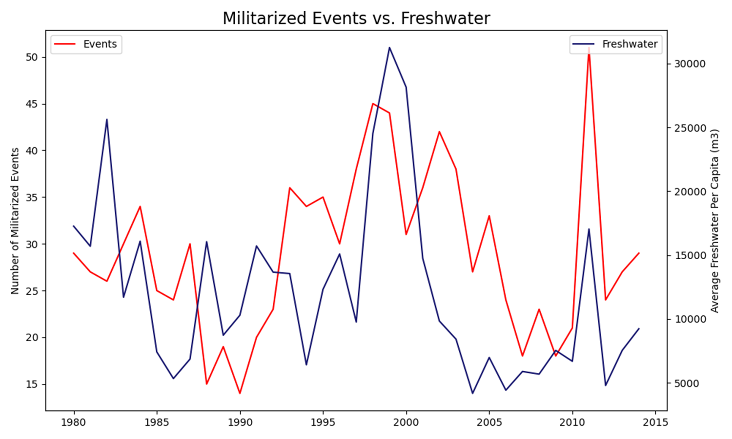
Topic 4: Average Freshwater Analysis
Conflicts and Freshwater over time appear to be slightly correlated.
The calculated r-value is 0.16, indicating a very weak positive correlation.

Slide 18
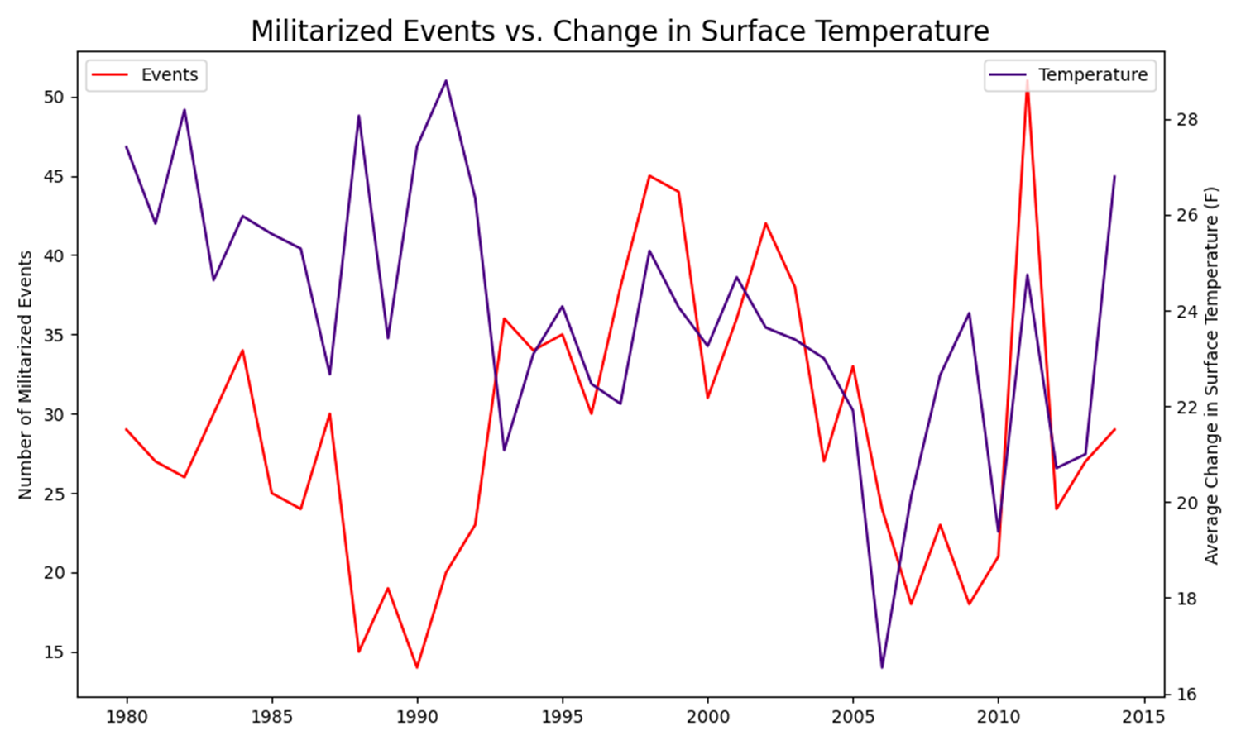
Topic 4: Average Surface Temperature Analysis
Conflicts and surface temperature over time appear to be slightly correlated.
The calculated r-value is 0.04, indicating almost no correlation.

